Slide 1
Question-Answering System
Final Project discussion
Praneeth,200050028
Janaki Ram,200050112
Varun,200050073
Samarth,19d180029
30th April 2023

Slide 2
Problem Statement
Building Question-Answering System in
Telugu, English and Hindi.
For each observation in the training set we have a context, question, and answer.
The goal is to find the answer for any new question and context provided.
We used “Extractive Question Answering” Method. This involves posing questions about a document and identifying the answers as spans of text in the document itself. This makes it a closed dataset meaning that the answer to a question is always a part of the context and also a continuous span of context.

Slide 3
Problem Statement - Contd.
Building Question-Answering System in
Telugu, English and Hindi.
The context can be in any of the three languages: Telugu, English and Hindi.
The question can also be in any of the three languages mentioned above.
We used google-translate API to translate any text to English before passing it to our model.

Slide 4
Related works
Pranav Rajpurkar, Jian Zhang, Konstantin Lopyrev, Percy Liang : SQuAD: 100,000+ Questions for Machine Comprehension of Text
Link to Paper
A. Conneau, D. Kiela, H. Schwenk, L. Barrault, A. Bordes :
Supervised Learning of Universal Sentence Representations from Natural Language Inference Data
Link to Paper

Slide 5
Dataset
Stanford Question Answering Dataset (SQuAD) is a new reading comprehension dataset, consisting of questions posed by crowdworkers on a set of Wikipedia articles, where the answer to every question is a segment of text, or span, from the corresponding reading passage. With 100,000+ question-answer pairs on 500+ articles, SQuAD is significantly larger than previous reading comprehension datasets.

Slide 6

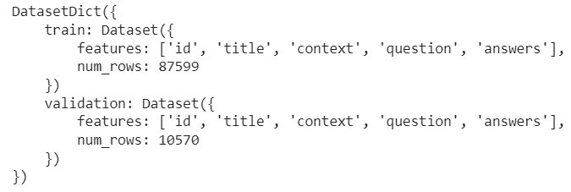
Dataset Contd.
Loading the Dataset:
print(raw_datasets):

Slide 7
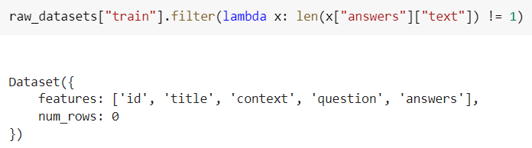
Dataset Contd.
The training dataset has only one possible answer while the validation dataset has several possible answers, which may be same or different

Slide 8
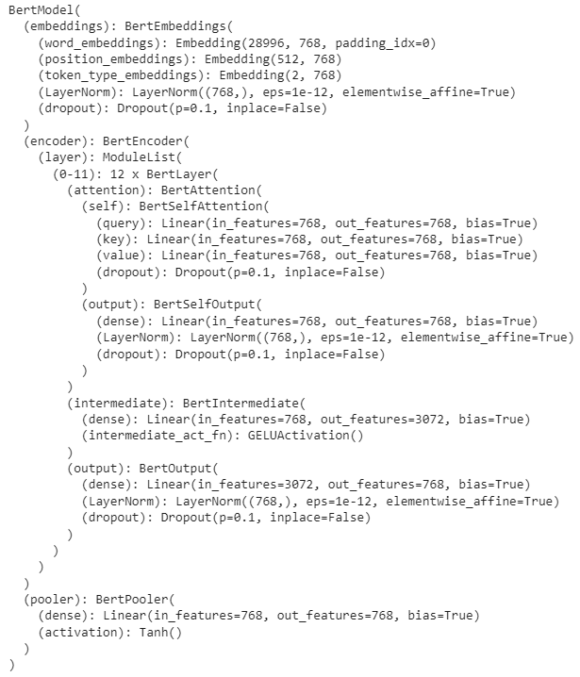
Workflow, Architecture, Technique
We have used a BERT Model (Bidirectional Encoder Representations from Transformers) and fine-tuned it for our task.
The Architecture of this model is shown in the picture on the right-side.
We chose BERT, which is an encoder model, because it is less complex than other encoder-decoder architectures such as BART, owing to its training cost.

Slide 9
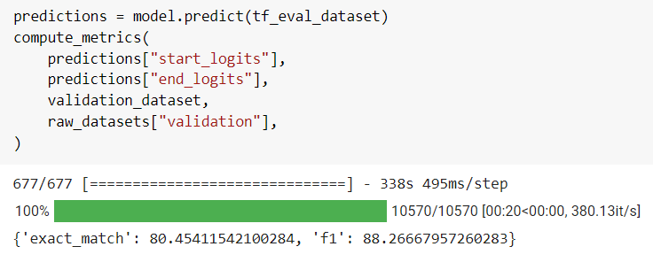
Results and Analysis

Slide 10
Results and Analysis
BERT worked pretty well in extracting answers for factoid questions like “Who is the current captain of CSK?” but fared poorly when given open-ended questions such as “Is Dhoni the best captain?”.
This is because we trained the model on dataset which has fact-based questions with explicit answers. To answer open-ended questions, it needs better interpretation and understanding.
Answering open-ended questions might also come under the category of generative tasks which is tough for BERT as it’s language and concepts of relations between words is limited to the training data and also due to its MLM objective.
Although MLM objective is useful for learning representations of words and their relationships with other objects, it is not as effective for learning how to generate grammatically correct text.

Slide 11
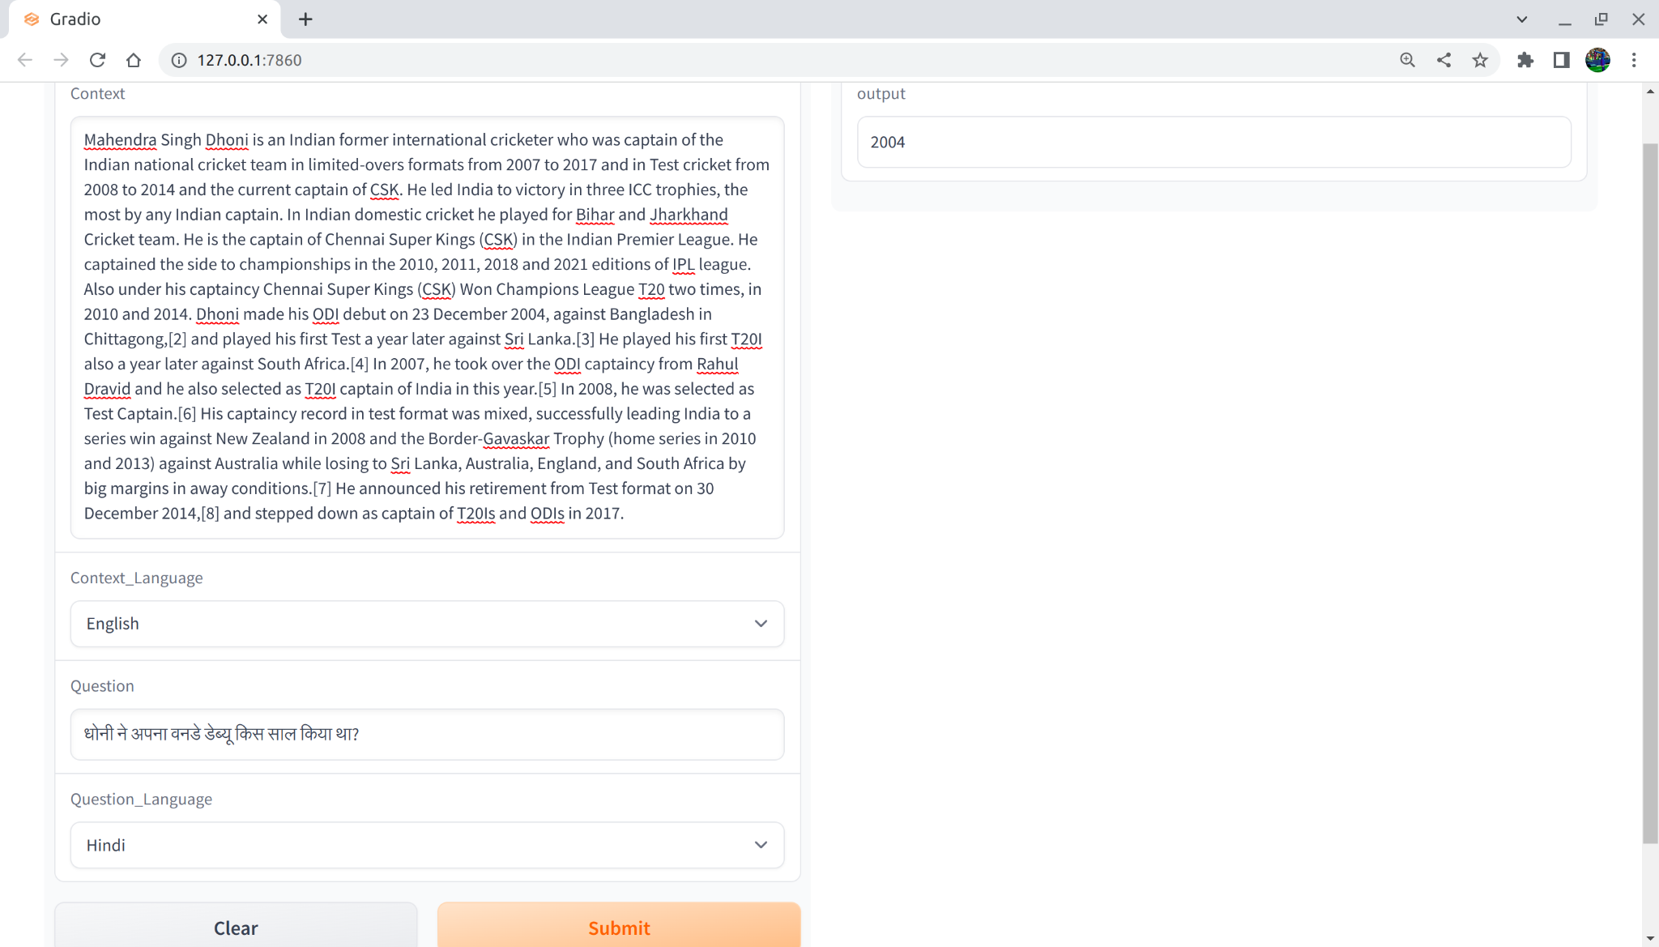
Results
Context-English
Question-Hindi

Slide 12
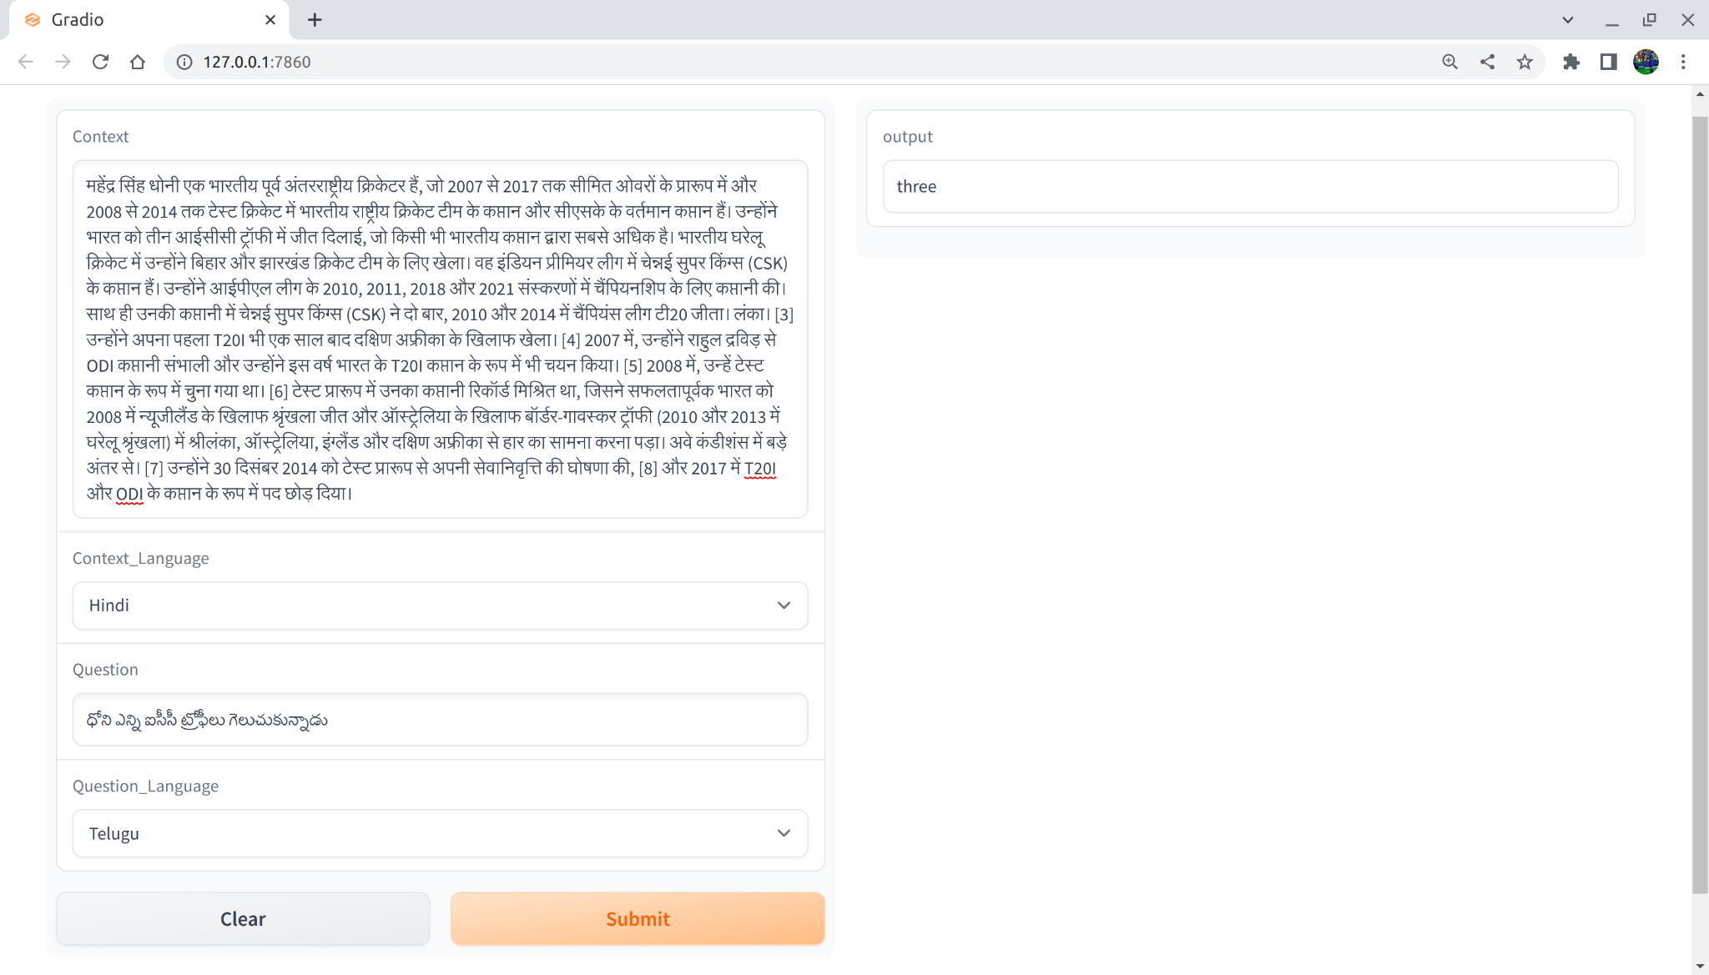
Results
Context-Hindi
Question-Telugu

Slide 13
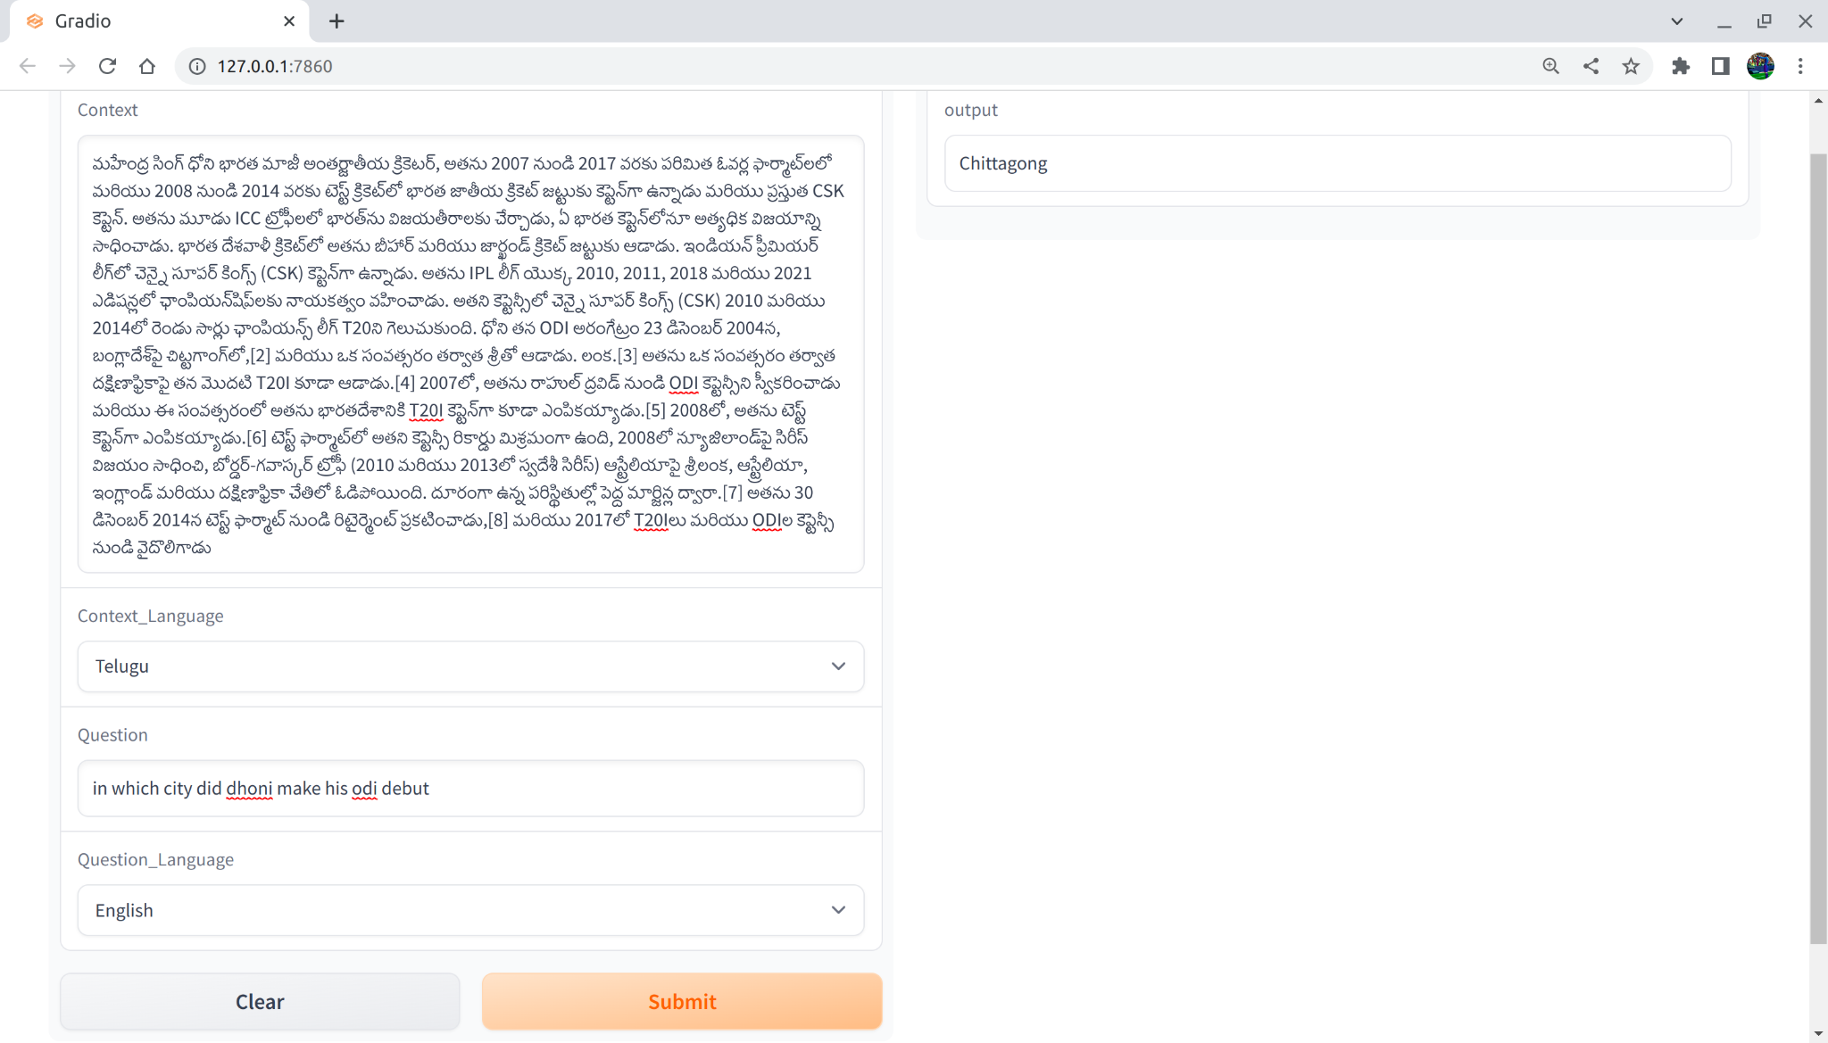
Results
Context-Telugu
Question-English

Slide 14
Demo

Slide 15
Evaluation Scheme
1. Attractive and complex problem: 5
2. Clarity in task and in input-output description: 5
3. Dataset effort- collection, annotation: 10
4. Workflow, Architecture, technique: 10
5. Results and analysis: 10
6. Demo working: 20

